Slide 1
20MCA281- INTERNET OF THINGS
MODULE 2: Programming Frameworks For
Internet Of Things

Slide 2
PROGRAMMING FRAMEWORKS FOR INTERNET OF THINGS

Slide 3
Overview
IoT devices are generally characterized as small things in the real world with limited storage and processing capacity, which may not be capable of processing a complete computing activity by themselves.
IoT with Cloud will create new avenues for computing:
huge storage capacity for IoT data in cloud; massive computing capabilities to collect , analyze, process, and archive those data;
new platforms such as SaaS (Sensing as a Service), SAaaS (Sensing and Actuation as a Service), and VSaaS (Video Surveillance as a Service) will open up to users.
•

Slide 4
…Overview
Major set of challenges for IoT application developers:
Heterogeneity
Heterogeneity spans through hardware, software, and communication platforms.
Volume of data generated
The data generated from these devices are generally in huge volume, are in various forms, and are generated at varying speeds.
Developing a simplified programming model that can provide solutions for the above challenges
will remain a continuous pursuit for the IoT community

Slide 5
…Overview
A complete programming framework in a distributed environment requires not only a stable computing language such as C, but also a coordination language that can manage communications between various components of an IoT ecosystem.
An explicit coordination language can tackle many of the challenges:
It can manage communication between heterogeneous devices.
It can coordinate interaction with the Cloud and devices, handle asynchronous data arrival.
It can also provide support for fault tolerance.

Slide 6
Embedded DeviceProgramming Languages
There are various programming languages in the embedded programming domain, but about 80%, are either implemented in C and its flavours, or in a combination of C and other languages such as C++.
Some of the striking features of C that aid in embedded
development are:
performance,
small memory foot-print,
Access to low-level hardware,
availability of a large number of trained/experienced C Programmers
short learning curve
compiler support for the vast majority of devices

Slide 7
…Embedded Device Programming Languages
Many embedded C-compilers based on ANSI C usually:
support low-level coding to exploit the underlying hardware,
support in-line assembly code
flag dynamic memory-allocation and recursion
provide exclusive access to I/O register,
support accessing registers through memory pointers
allow bit-level access.
Some of the flavours of C used in embedded programming.
nesC
Keil C
Dynamic C
B#

Slide 8
nesC
nesC is a dialect of C that has been used predominantly
in sensor-nodes programming.
It was designed to implement TinyOS , an operating system for sensor networks.
It is also used to develop embedded applications and libraries.
In nesC, an application is a combination of scheduler and components wired together by specialized mapping constructs.
To improve reliability and optimization, nesC programs are subject to whole program analysis and optimization at compile time.

Slide 9
Keil C
Keil C is a widely used programming language for embedded devices.
It has added some key features to ANSI C to make it more suitable for embedded device programming.
To optimize storage requirements, three types of memory models are available for programmers: small, compact, and large.
New keywords such as alien, interrupt, bit, data, xdata, reentrant, and so forth, are added to the traditional C keyword set.

Slide 10
Keil C
Keil C supports two types of pointers:
generic pointers: can access any variable regardless of its
location
memory-specific pointers: can access variables stored in data memory
The memory-specific-pointers-based code execute faster than the equivalent code using generic pointers.
This is due to the fact that the compilers can optimize the memory access, since the memory area accessed by pointers is known at compile time.

Slide 11
Dynamic C
Some key features in Dynamic C are function chaining and cooperative multitasking.
Segments of code can be distributed in one or more functions through function chaining.
Whenever a function chain executes, all the segments belonging to that particular chain execute.
Function chains can be used to perform data initialization, data recovery, and other kinds of special tasks as desired by the programmer.

Slide 12
The order of execution of statements inside a function chain is not guaranteed.
Dynamic C’s costate statement provides support for cooperative multitasking. It provides multiple threads of control, through independent program counters that can be switched in between explicitly.

Slide 13
B#
B# is a multithreaded programming language designed for constrained systems.
Although C inspires it, its features are derived from a
host of languages such as Java, C++, and C#.
It supports object oriented programming.

Slide 14
Message Passing in Devices
Some of the communication paradigms and technologies that can be used in resource-constrained environments are,
RPC
REST
CoAP

Slide 15
RPC-Remote Procedure Call
RPC is an abstraction for procedural calls across languages, platforms, and protection mechanisms.
For IoT, RPC can support communication between devices as it implements the request/response communication pattern.
Typical RPC calls exhibit synchronistic behaviour.
When RPC messages are transported over the network, all the parameters are serialized into a sequence of bytes.
Since serialization of primitive data types is a simple concatenation of individual bytes, the serialization of complex data structures and objects is often tightly coupled to platforms and programming languages.
This strongly hinders the applicability of RPCs in IoT due to interoperability
concerns.

Slide 16
Lightweight Remote Procedure Call (LRPC)
Lightweight Remote Procedure Call (LRPC) was designed for optimized communication between protection domains in the same machine, but not across machines.
S-RPC is another lightweight remote procedure-call for heterogeneous WSN networks.
– S-RPC tries to minimize the resource requirements for encoding/decoding and data buffering.

Slide 17
REST- REpresentational State Transfer
Roy Fielding in his PhD thesis proposed the idea of
RESTful interaction for the Web.
The main aim of the REST was to simplify the web- application development and interaction.

Slide 18
…REST
It leverages on the tools available on the Internet and stipulates the following constraints on application development:
Should be based on client-server architecture and the servers should be stateless
Support should be provided for caching at the client side
The interface to servers should be generic and standardized (URI)
Layering in the application architecture should be supported and each of the layers shall be independent
Optional code-on demand should be extended to clients having the capability

Slide 19
…REST
These constraints, combined with the following principles, define the RESTful approach to application development.
Everything on the Internet is a resource
Unique identifiers are available to identify the resources
Generic and simple interfaces are available to work with those resources
Communication between client and servers can be through
representation of resources
Resource representation through sequence of bytes is followed by some metadata explaining the organization of the data
Since transactions are stateless, all interactions should be context- free
Layering is supported, and hence intermediaries should be transparent

Slide 20
…REST
The constraints and principles bring in many
advantages to the distributed applications:
scalability
loose coupling
better security
simple addressability
connectedness
performance.
But it also narrows the focus of RESTful approaches to
data and its representation
The RESTful approach poses a challenge for those applications that require stateful interactions.

Slide 21
CREST (Computational REST)
CREST focus is on exchanges of computation rather than on data exchange.
Instead of client-server nomenclature, everyone is addressed as peers; some may be strong and some may be weak, based upon the available computing power.
Functional languages such as Scheme allow computations to be suspended at a point and encapsulated as a single entity to be resumed at a later point in time, through “continuation.”

Slide 22
…CREST
CREST has some principles:
All computations are resources and are uniquely identified
Representation of resources through expressions and metadata
All computations are context-free
Support for layering and transparent intermediaries
All the computations should be included inside HTTP
Computations can produce different results at different times
Between calls they can maintain states that may aid computations such as aggregation
Between different calls, computations should support independence
Parallel synchronous invocations should not corrupt data

Slide 23
CoAP- Constrained Application Protocol
The IETF work group, Constrained RESTful Environments (CoRE), has developed the web-transfer protocol CoAP, which is optimized for constrained power and processing capabilities of IoT.
CoAP in simpler terms is a two-layered protocol:
a messages layer, interacting with the UDP,
Another layer for request/response interactions using methods
and response code, as done in HTTP.
In contrast to HTTP, CoAP exchanges messages asynchronously and uses UDP

Slide 24
…CoAP
HTTP versus CoAP
CoAP is more efficient for applications on smart objects, engaged in frequent communication sessions
CoAP is cost-effective whenever the battery/power-source replacements prove costly
Whenever the charges for the data communication are volume- based, CoAP is found to be more cost-effective
CoAP has been found to be more beneficial cost-wise in push mode than in pull mode

Slide 25
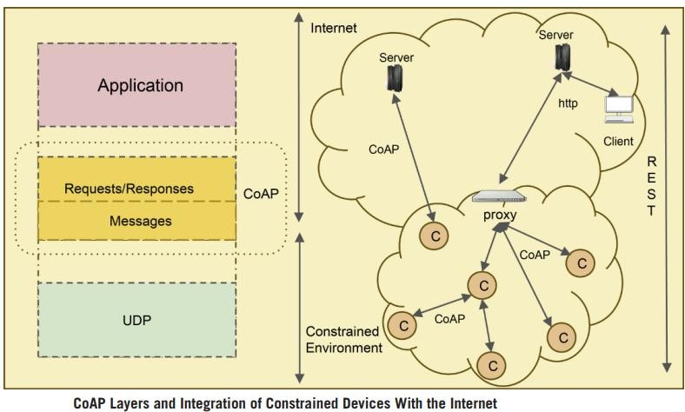

Slide 26
Coordination Languages
Complete programming model can be built by combining two orthogonal models:
Computation model
It provides the computational infrastructure and programmers can build computational activity using them
Coordination model
It provides the support for binding all those computational activities together.

Slide 27
Coordination can be seen through two different perspectives:
based on centralized control, named as Orchestration
“the definition of the sequences and conditions under which multiple cooperating independent agents exchange messages in order to perform a task to achieve a goal state.”
based on distributed transparent control, named as
Choreography
“the definition of sequence and conditions in which one single agent invokes other agents in order to realize some useful function.”

Slide 28
Linda
Linda is a coordination-programming model for writing parallel and distributed applications.
It takes the responsibility of enforcing communication
and coordination.
The Linda model supports a shared-memory store called tuple space for communication between processes of the application.
Tuple spaces can be accessed by simple operations such as “out” and “in.”
These operations can be either blocking or non-blocking.
CppLINDA is a C++ implementation of the Linda coordination model.

Slide 29
eLinda
The eLinda model extends Linda.
It adds a new output operation “wr” that can be used with the “rd” input operation to support broadcast communication.
eLinda proposes the “Programmable Matching Engine”.
The PME allows the programmer to specify a custom matcher that can be used internally to retrieve tuples from the shared store.
The PME has been found to be advantageous for parsing graphical languages and video-on-demand systems.

Slide 30
Orc
Orc is a coordination language for distributed and
concurrent programming.
It is based on process calculus.
It provides uniform access to computational services, including distributed communication and data manipulation.

Slide 31
Features of Orc
The basic unit of computation in Orc is called a site, similar to a function or a procedure in other languages. The sites can be remote and unreliable.
Sites can be called in the form of C(p); C is a site name and p is the list of parameters. The execution of a site- call invokes the service associated with the site. The call publishes the response if the site responds.
Orc has combinator-operators to support various compositions and work-flow patterns.
Orc provides several fundamental sites, such as Rwait(t), Prompt(), and so forth, to promote writing efficient programs.
The recent Orc implementation is allowing Java classes
to be used as sites.

Slide 32
Jolie
Jolie (Java Orchestration Language Interpreter Engine) is an orchestration language for services in Java-based environments.
The statement composers and dynamic fault handling are two important features in this language:
In dynamic fault handling , instead of fault handlers being statically programmed, they are installed dynamically at the execution time.
– This facilitates fine-tuning of fault handlers and termination handlers, depending upon which part of the code has already been executed.
•

Slide 33
In Jolie there are basically three statement composers:
Sequence
statementx ; statementy
parallel
statementx | statementy
input choice
[IS_1] {Branch_Code_1} [IS_2] {Branch_Code_2}
[IS_3] {Branch_Code_3}

Slide 34
Polyglot Programming
Polyglot programming is also called multilingual
programming.
It is an art of developing simpler solutions by combining the best possible solutions using different programming languages and paradigms.
It is also called poly-paradigm programming (PPP) One of the oldest examples of polyglot programming is
Emacs, which is a combination of parts written in both C and eLisp (dialect of Lisp).
Polyglot programming has been observed to have increased programmer productivity and software maintainability in web development.

Slide 35
Polyglot Programming-Definitions
“programming in more than one language within the same context.”
“using multiple programming languages on the same managed run-time”
“programming in more than one language within the same context, where the context is either within one team, or several teams where the integration between the resulting applications require knowledge of the languages involved”

Slide 36
…Polyglot Programming
In a Polyglot programming environment, the platform used for the integration, and the different programming languages supported by the given platform are the two essential aspects.
An Inverse pyramid can be used to categorize the programming languages in a polyglot software system. The Inverse pyramid has three layers:
stable,
dynamic,
domain,
The inverse pyramid signifies the fact that it is the single stable language, which supports all of the previously described layers and various languages in a bedrock fashion.

Slide 37
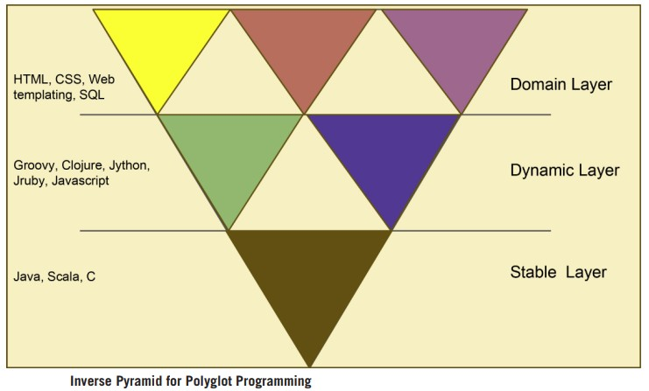

Slide 38
Features of Programming Frameworks for IoT
Coordination: An IoT can have computing elements playing different roles: controllers, storage managers, and application processors. We need programming-language support for orchestrating their activities.
Heterogeneity: The IoT brings disparate computing devices together for the purposes of running smart-computing applications. The programming framework should be capable of efficiently exploiting the system heterogeneity by allowing the developer to provide guidance on how the computations must be mapped to the computing elements.

Slide 39
…Features of Programming Frameworks for IoT
Scalability: For IoT to become a success, it is not sufficient to just interconnect massive numbers of devices. They should be programmed to run many creative applications, such that massive numbers of users would benefit from their deployment and should also be able to perform load- balancing dynamically.
Fault tolerance: In IoT, chance for frequent system partitioning due to the mobility of computing elements. The programming framework should allow developers to create applications that can go between online and offline states as networks partition and heal their connections.

Slide 40
…Features of Programming Frameworks for IoT
Lightweight footprint: The programming framework should be lightweight both in terms of the runtime overhead and the programming effort needed by the developers.
Support for latency-sensitive applications: IoT will have many applications which would be
geographically distributed and hence may be latency- sensitive. The programming framework, including the runtime, has to support these sorts of requirements dynamically.

Slide 41
IoT Programming Approaches
Node-Centric Programming:
Here, every aspect of application development, communication between nodes, collection and analysis of sensor data, and issuing of commands to actuator nodes has to be programmed by the application developer. Although it has greater control over the way that programs work, it is too labour-intensive and does not promote portability.
Database approach: In this model, every node is considered to be a part of a virtual database. Queries as part of an application can be issued on sensor nodes by the developer. This model does not support application logic at this level, rendering it to be of little use in IoT application development.

Slide 42
…IoT Programming Approaches
Macro Programming: In this methodology, application logic can be specified and also abstractions are provided to specify high-level communication, thereby hiding low- level details from developers, which will aid in modular and rapid development of applications.
Model-Driven Development:
This takes note of both vertical and horizontal
separation of concerns.
Vertical separation increases the level of abstraction, thereby reducing application development complexity.
Horizontal separation of concern reduces development complexity by describing the system, using different system views.
Each perspective elaborates on a certain aspect of the
system.

Slide 43
Existing IoT Frameworks
Mobile Fog
ELIoT
Compose API
Distributed Dataflow support for IoT
PyoT
Dripcast
Calvin
Simurgh
High level Application Development for IoT
PatRICIA

